Slide 1







Autonomous Navigation and On Board Autonomy for Space Exploration Systems
PhD Student
Jasmine Rimani
Tutors:
Stéphanie Lizy-Destrez, ISAE-SUPAERO
Nicole Viola, PoliTO

Slide 2


Table of Context
Updates MBSE/SysML to HDDL:
Generalities
SysML Scheme from Papyrus
Generalization of Domain File
Generation of Problem File
Feedback Back to Papyrus
Conclusions

Slide 3
Generalities (i)
The MBSE scheme from Vitech Genesys has been translated directly to the open-source software Papyrus.
The graphic of the software and its use is a bit less appealing than Genesys. However, the export is an XML file that can be parsed in Python to generate the domain and problem files.
The domain file can be totally generalized for multiple applications using UseCase and Activities diagrams.
I couldn’t find a way to totally generalize the problem file. However, for the application of robotic exploration it can be generalized using the information of:
Components defined through component diagrams
Map from SLAM created as txt file and notions about how the system moves:
This txt file it’s a direct manipulation of the information from the map.
Activity diagram of the mission to get the ordering of the tasks
The initial task network is given as input by the designer

Slide 4
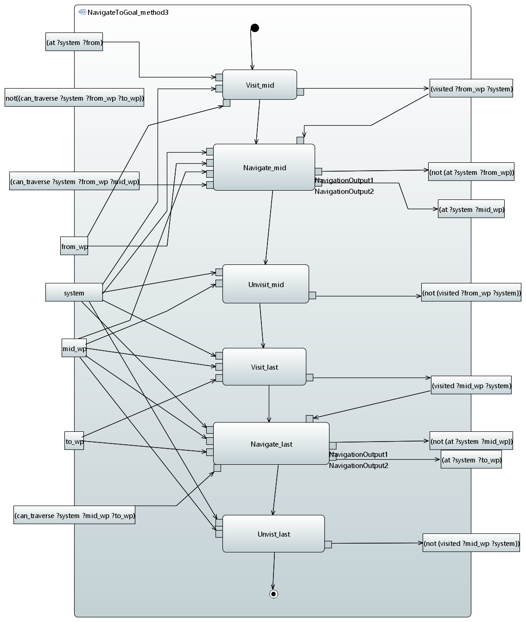
Generalities (ii)
With the use of Papyrus, we solved the problems of the first translation:
The predicates and repeated functions can be displayed in an activity diagram. The translation module recognize and generalize the same action based on the input/output set.
E.g. in the example in this slide, the software recognize that the Navigate_mid and Navigate are the same action and insert it only once in the domain file.
However, the graphical interface helps defining the domain of the problem.

Slide 5
Generalities (iii)
Requirements in HDDL:
Comment attached to the mission requirement folder
Types in HDDL:
Classes
Predicates in HDDL:
Activity Parameters
Constraints
Comparison between Functions and HDDL Tasks
Task: Use Cases
Methods: Use Cases
Actions: Activities
The ordering of the different actions is given in the activity diagram

Slide 6
Generalities (iv)
Domain File Data Analysis
Domain File Creation
Feedback file creation
Start
Parsing Module
Check the model
End
Problem File Data Analysis
Problem File Creation
Log file creation
The structure of the software is quite linear:
It takes the input files, save the data in nested dictionaries and then it outputs the final domain and problem files.
Some interesting info:
The xml file is parsed using “BeautifulSoap” in Python.
The “xmi:id” of the Papyrus xml file is created with the “uuid” library of Python in the feedback file.

Slide 7
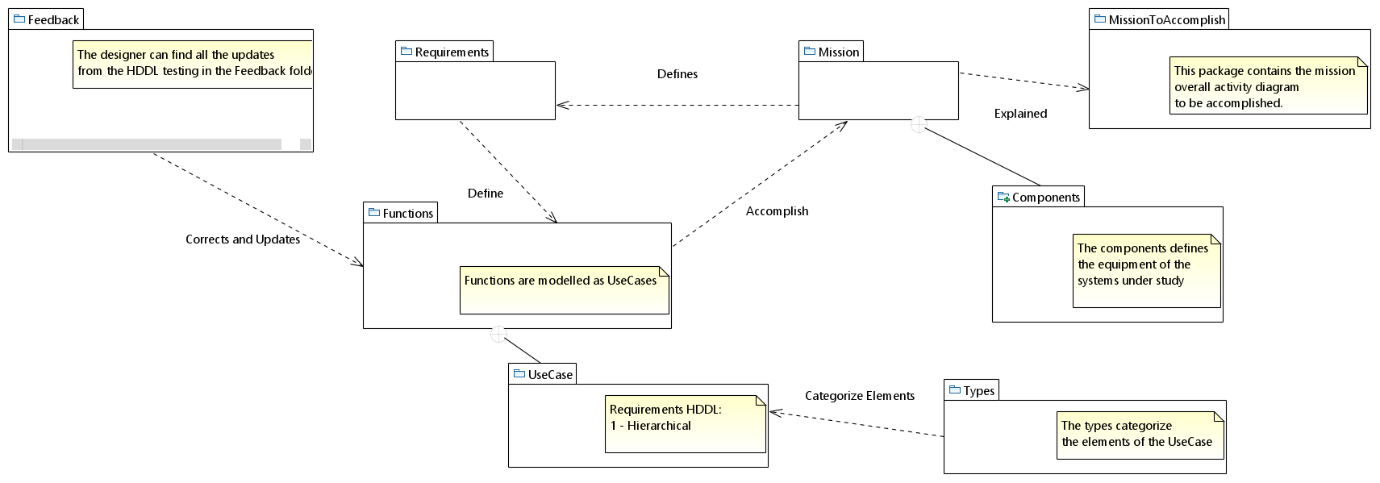
SysML Scheme from Papyrus (i)
Organization of the packages in Papyrus for the MBSE-HDDL Translation
The model istances are grouped in subfolders each of them with specific information on the mission.

Slide 8
SysML Scheme from Papyrus (ii)
Organization of the packages in Papyrus:
Requirements: all the functional requirements are listed in a table here.
I didn’t use the SysML extension of Papyrus because is quite unstable – for now everything is creating with the pure UML scheme adapted to our use.
Functions: we have all the high-level functions, or tasks, as UseCases and each of them is then divided in different methods, that are detailed in Activity diagrams.
Mission: we have all what concerns the automatic generation of problem file for space exploration.
Feedback: it is a folder where the feedbacks from HDDL will be highlighted. All the requirements, types, predicates, task, methods and actions of the HDDL domain file are compared with the one from the original XML file.
Create a new XML file – that can be read by papyrus (in coding)
Create a simple log file to be provided to the System Engineer (in coding)

Slide 9
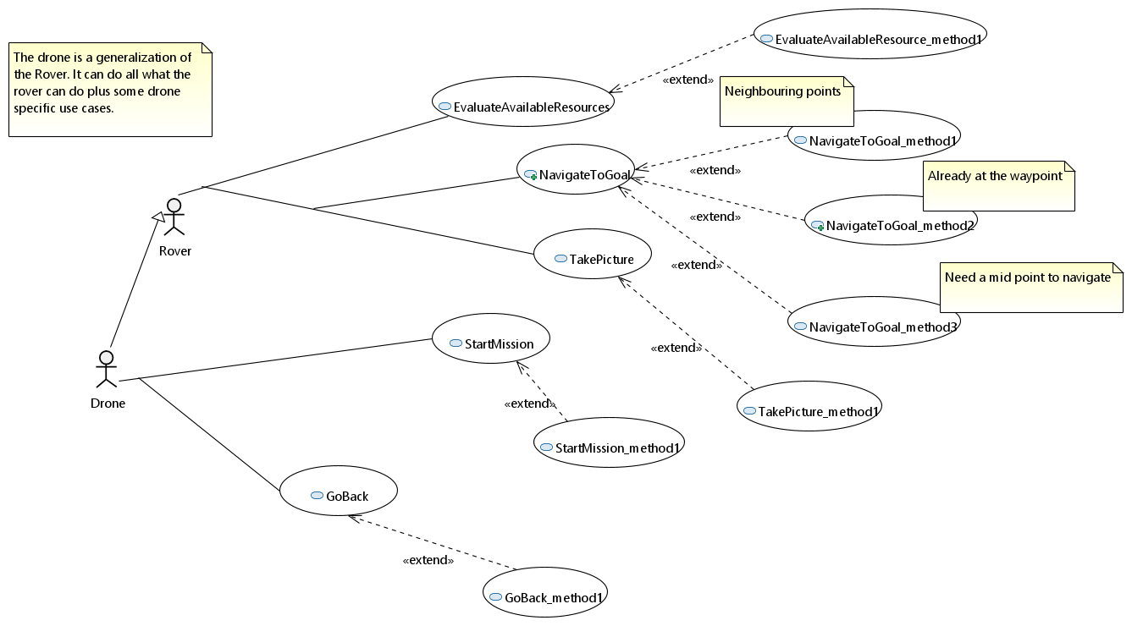
Generalization Domain File (i)
We start with a UseCase where all the functions derived from the requirements are shown as well as their methods.

Slide 10
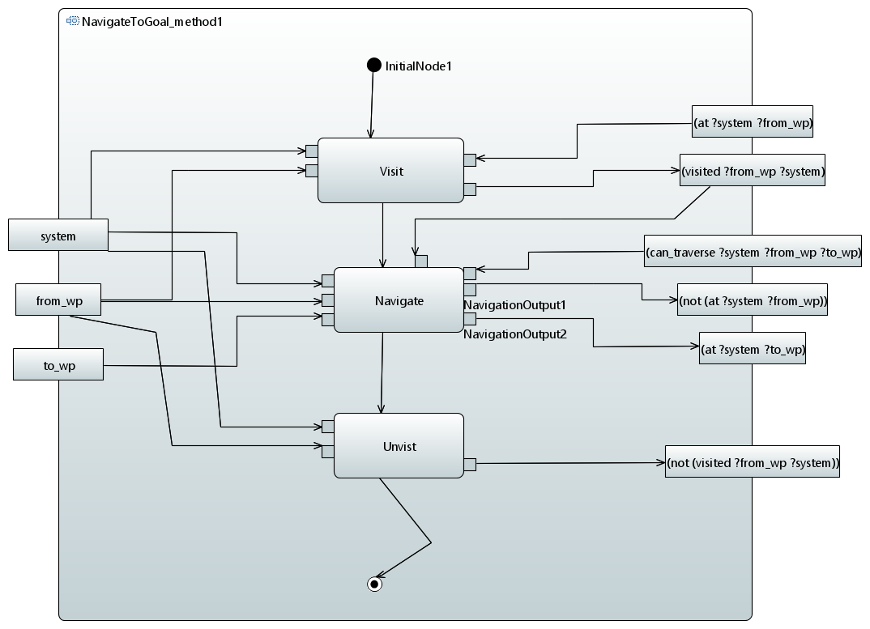
Generalization Domain File (ii)
For each method we define an activity diagram with the inputs and outputs that enable the different “Opaque Actions” to be executed.

Slide 11
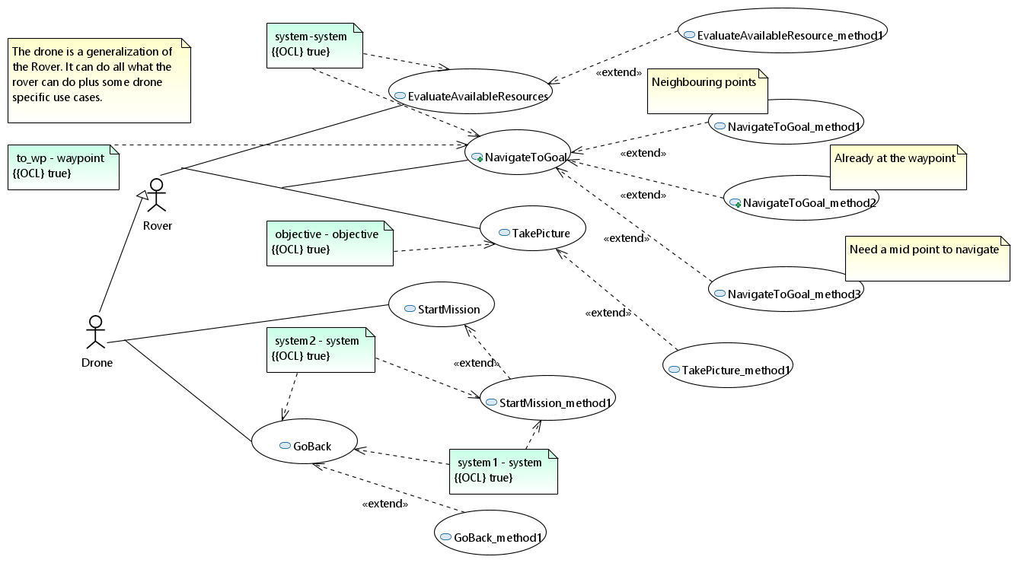
Generalization Domain File (ii)
If we want to specify the parameters for each useCase we can use the constraint element.

Slide 12
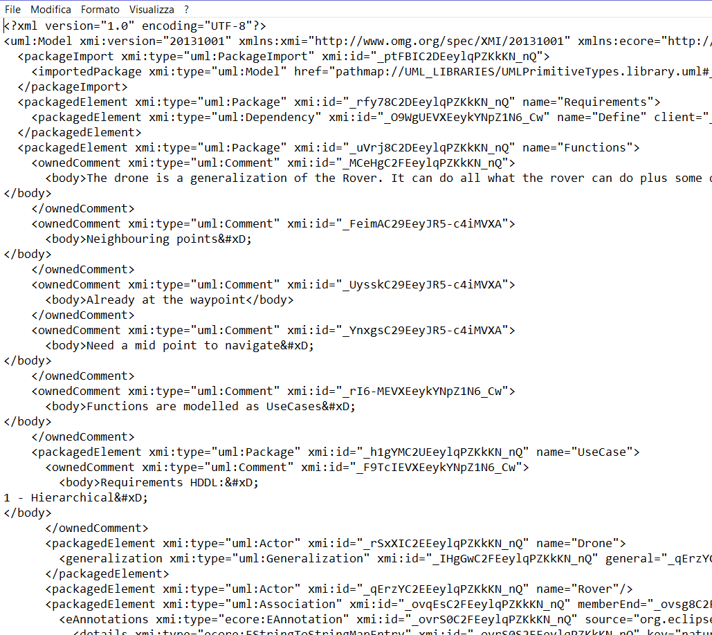
Generalization Domain File (iii)
We get the XML in output and analyze its tags to automatically translate it to our domain file.
I will spend some paragraphs in the paper describing the tags in the xml files and how the algorithm works.
The data frame is defined by a series of nested dictionaries:
{'name': 'Visit', 'xmi:type': 'uml:OpaqueAction', 'xmi:id': '_uzdYMC2bEeylqPZKkKN_nQ', 'incoming_link': '_r8VAwC2gEeylqPZKkKN_nQ', 'outcoming_link': '_odRf8C2gEeylqPZKkKN_nQ', 'method': '_AFI5YC2yEeyropzrv_OlDA', 'task': '_a2yF0C2EEeylqPZKkKN_nQ', 'preconditions': {'(at ?system ?from_wp)'}, 'effects': {'(visited ?from_wp ?system)'}, 'parameters': {'system-system', 'from_wp-waypoint'}}

Slide 13
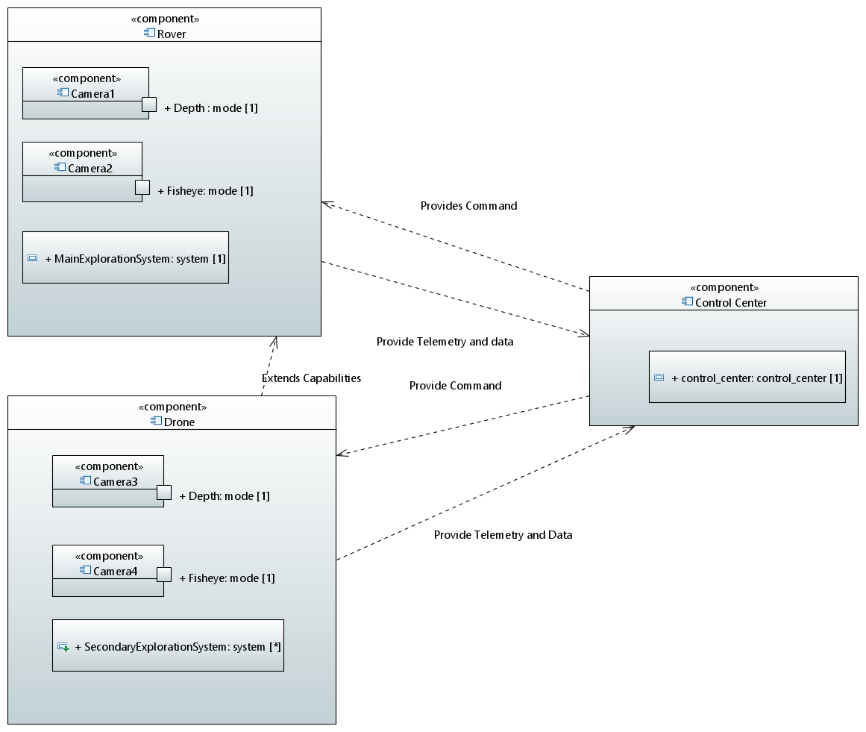
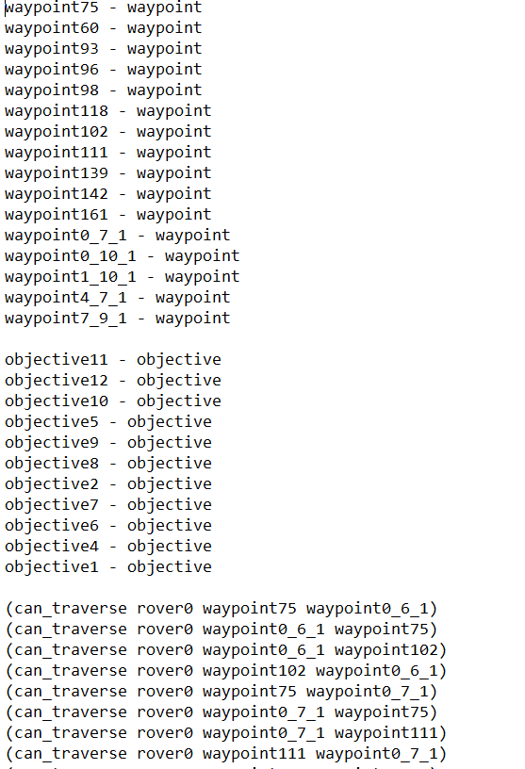
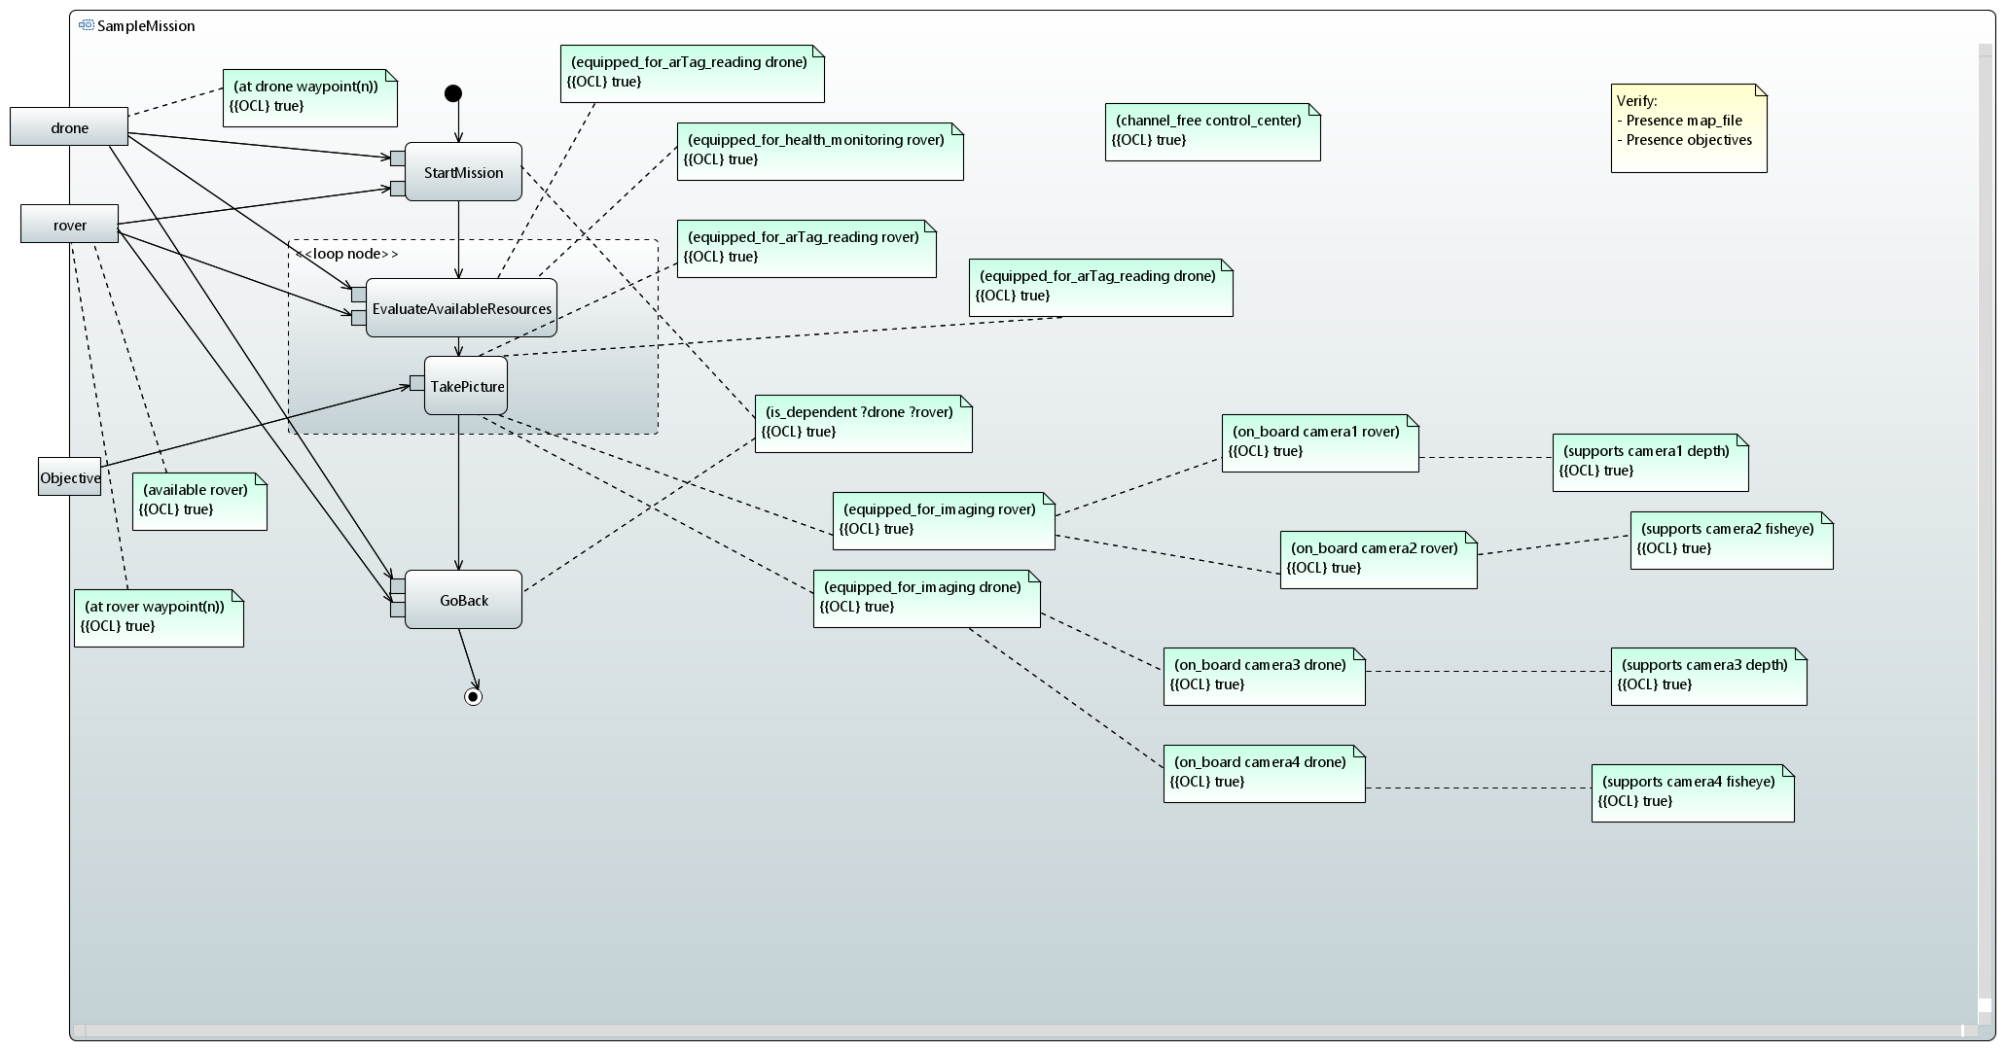
Generation of Problem File
Knowing components, map and hierarchy of the main tasks – we can generate the domain file:
The hierarchy defines which tasks have to be accomplished before.
The initial task network is given as input file.

Slide 14
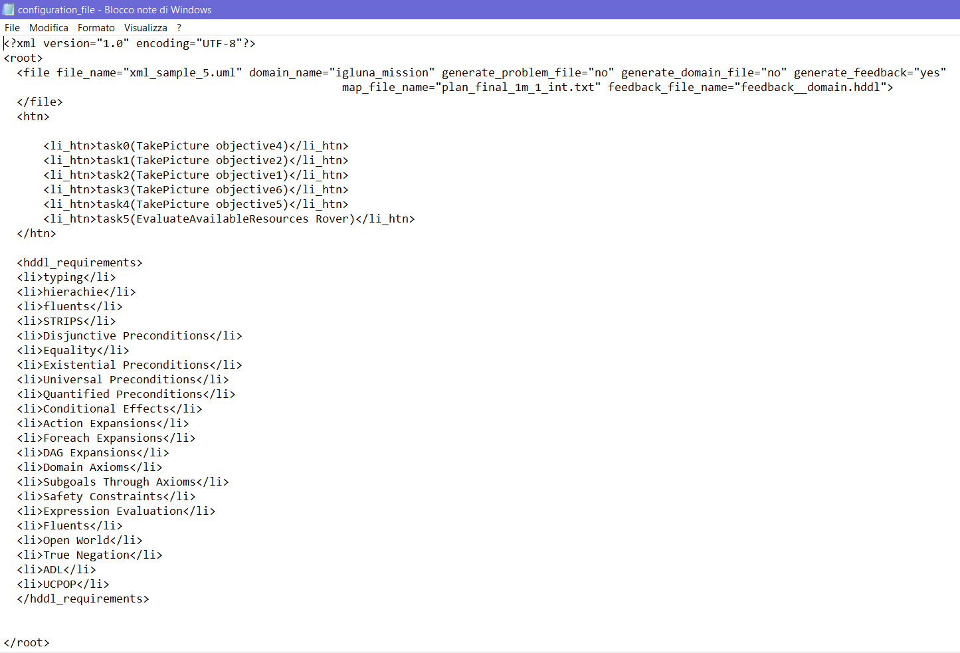
Input File
Specification of the name of the Papyrus model, if the user want a specific name for the domain file, if we want to generate a problem file as well, if we want to generate a feedback file.
Initial task network
All the possible requirements for the domain.
Which requirement to use is specified in the Papyrus model

Slide 15
Conclusions...
The coding of the main translation is almost done – I want to improve some parts of it, as always.
The coding of the feedback line is ongoing.
However, the core of the translation is there and I am thinking about writing a paper about it!

Slide 16
Tutorial (i)
Define UseCase:
For each requirement define a function to be accomplish that will become a HDDL task.
The requirement are defined as a table (generic table in the UML scheme/ requirement table in the SysML scheme).
For each function define at least on method, based on the initial possible parameters. The methods explains «how?» the task will be accomplished
The links between actors and UseCases and as well as the link intra UseCases are used as an aid to the modelling, they are not needed for the domain creation.

Slide 17
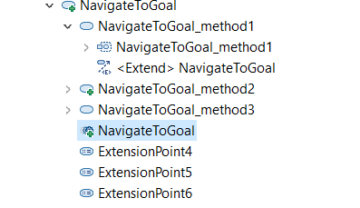
Tutorial (ii)
Comments:
Both tasks and methods are define as UseCases
The methods are nested inside the tasks (Papyrus uses a tree like interface).
Most dependencies are visualized through nested entities. If an entity is nested in the wrong point, we will get the wrong HDDL output.
Inside each Method UseCase, we will have an activity diagram that explains how that task can be accomplished starting from the initial conditions, and putting together the leaf functions (:actions)
If a :task is used as a :subtask in another :task, we need to associate a «OpaqueBehavior» so that we can maintain traciability with the corresponded :subtask.

Slide 18

Tutorial (iii)
Define Activity Diagram:
For each method we generate an activity diagrams with:
:actions as «uml: OpaqueAction»
:predicates/:parameters as «uml: ActivityParameterNode» (input/output of the activity)
This parameters are already classified with their :type as «uml:Class»
:task that are subtasks as «uml: CallBehaviorAction» associated to the «uml: OpaqueBehavior» .

Slide 19

Tutorial (iv)
If we want to create the problem file for a robotic exploration mission, we need:
A sample mission scenario- it’s an activity diagram with the main :task that we can call in our :htn ordered. If no order is enforced the software do not give any ordering.
The :htn can be defined by the designed in the initial file.
The initial conditions are expressed as constraints to the :task in the activity diagram.
The link between the constraints is used as aid to the modelling. They are not directly used in the problem file creation.
The map is retrieved from the map message of ROS and reprocessed in a series of predicates that expresse the traversability of the different zones.
The systems and the equipments are defined in an object diagram. Again the link between the objects are used to help in the design.
This mission diagram is put in the «Mission Folder».

Slide 20
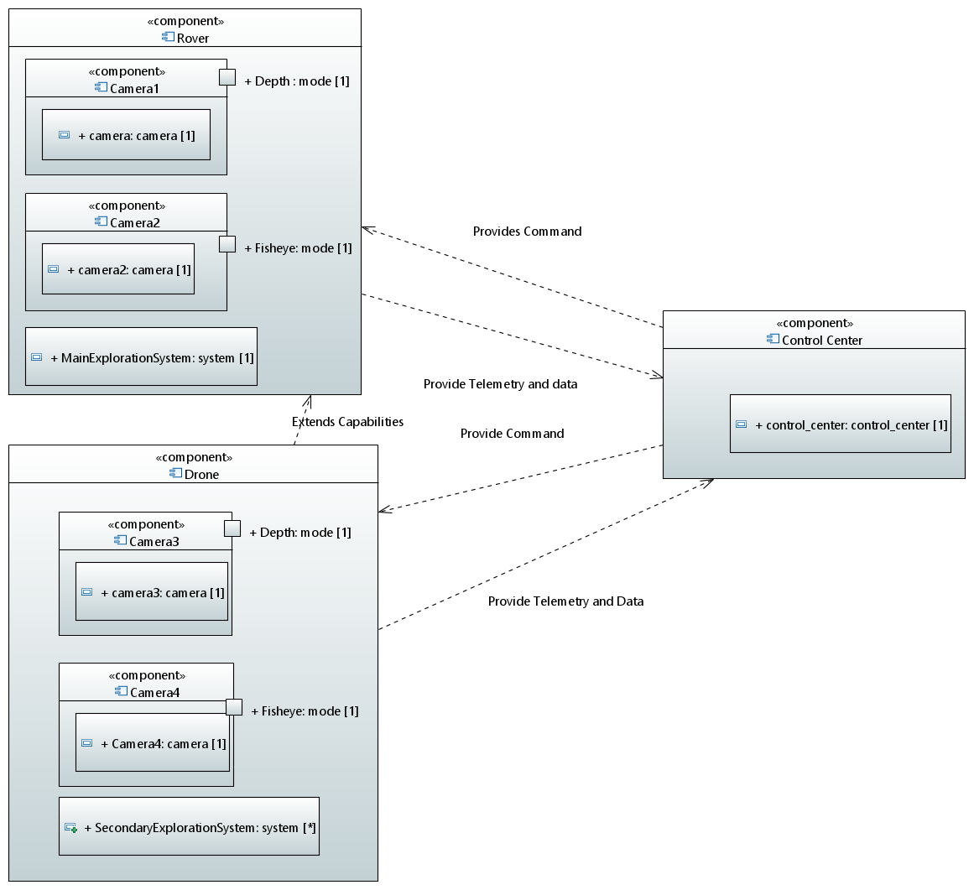
Tutorial (v)
The component diagram is used to define the «static equipments» of the problem.hddl file.

Slide 21
Thank you for your kind attention!!!
Jasmine ☺

